Slide 1



AX/FINANCE & OPS
San Antonio, Texas
October 13-17, 2024

Slide 2
Maximize Your X++ Mastery: Learn The Ultimate Tips and Tricks for Development Success

Slide 3


Nathan Clouse
Technical Architect
Armanino LLP
Email: nathan.clouse@armanino.com
Blog #1: https://www.atomicax.com
Blog #2: https://www.dynamics.fo
GitHub: https://github.com/NathanClouseAX
@NathanClouseAX on most platforms
Background:
Awarded Microsoft MVP in Business Applications since 2019
Been working with AX since 2009
Been working with D365FO since 2017
Have spoken at Summit, Focus, and local chapters around various AX/D365FO technical topics plus other groups events

Slide 4

Peter Ramer
Director of Managed Application Services
RSM
Email: peter.ramer@rsmus.com
Blog: http://dynamics365musings.com/
LinkedIn | Microsoft MVP Profile
Background:
Awarded Microsoft MVP in Business Applications since 2022
Been working with AX since 2006 and D365FO since 2016
Have written code that was then purchased and included into the standard F&O product.
Have a blog and YouTube channel that contains lots of technical tutorials.

Slide 5
Coding Tips
D365FO.Tools
Quality of Life Hacks
Debugging
Visual Studio Hidden

Slide 6
Coding Tips

Slide 7
Use Set Based Operations
Update_recordset rather than while select w/ update
RecordInsertList rather looped inserts
RecordInsertList rather than insert_recordset
Delete_from rather than while select update
Use new(ish) SysDA APIs
How To Insert Data In D365
How To Update Data In D365
How To Use Insert_recordset in D365
How To Use InsertDatabase in D365
D365 TTSBegin and TTSCommit

Slide 8
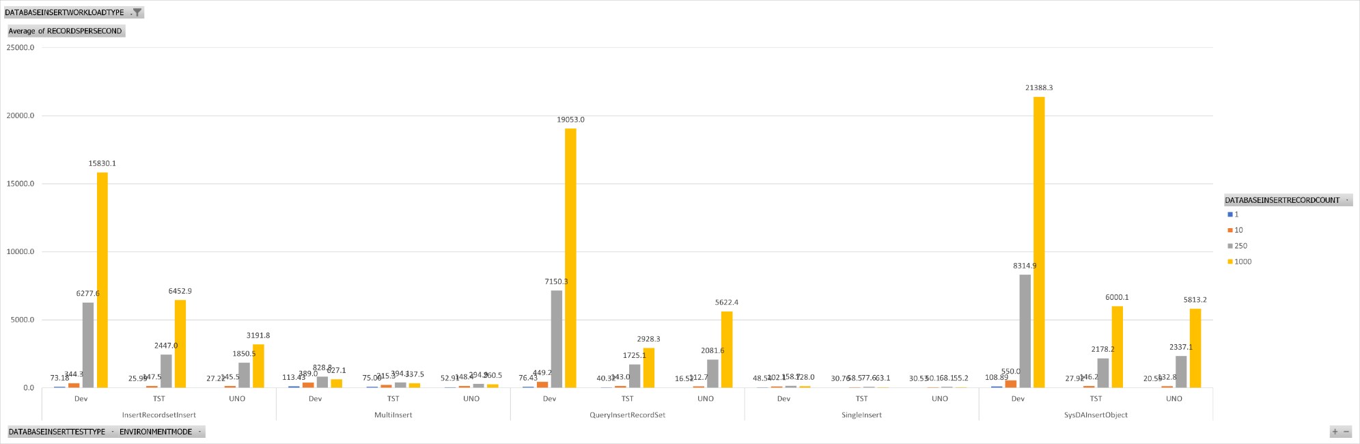
Set Based Operations

Slide 9
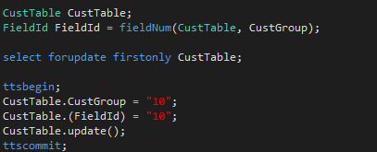
Using FieldNum Ordinals
Standard: CustTable.AccountNum
Using Ordinals: CustTable.(fieldNum(CustTable,AccountNum))

Slide 10
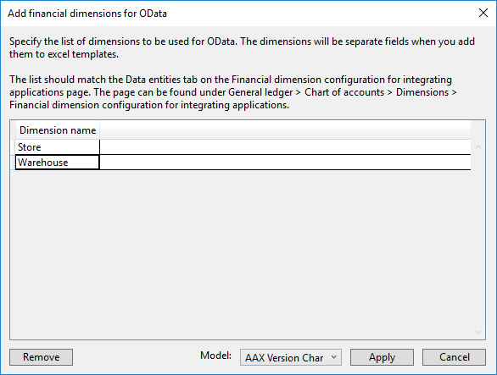
Add Financial Dimension for OData
Dynamics 365 > Addins > Add financial dimensions for OData

Slide 11
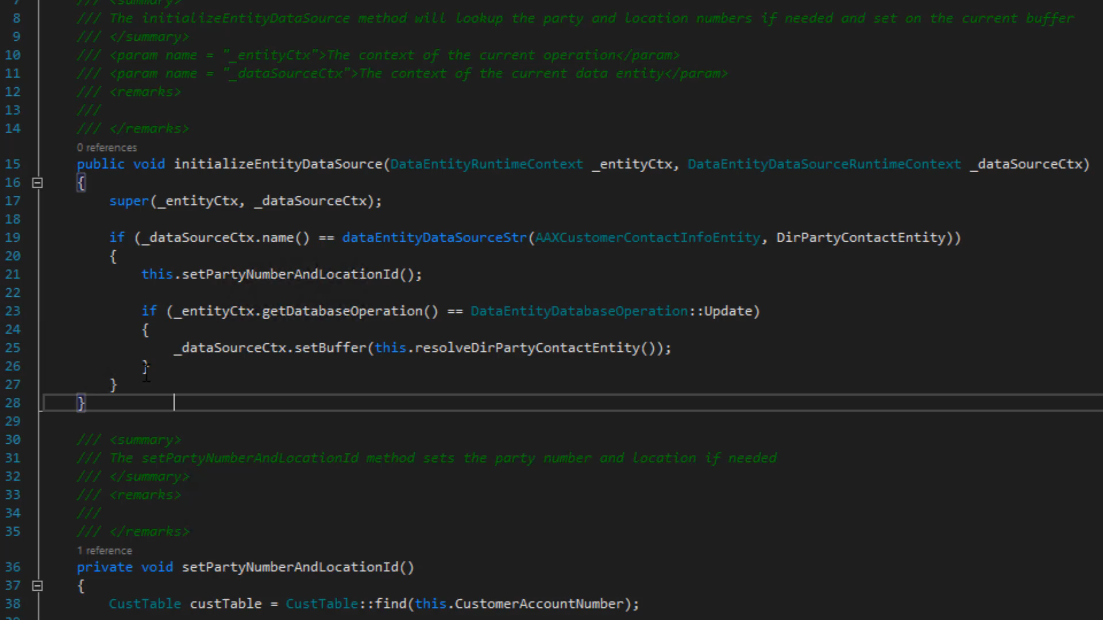
Comment Code

Slide 12
Uncomment Code
CTRL K, CTRL U

Slide 13
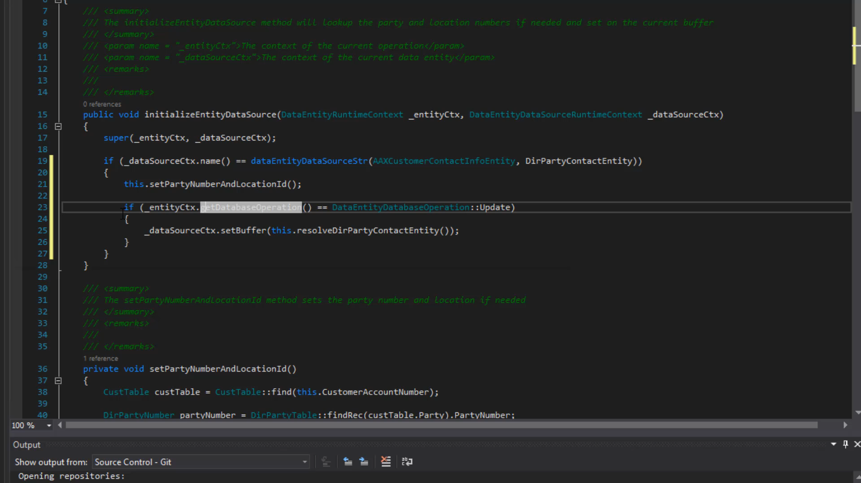
Format Code
CTRL K , D

Slide 14
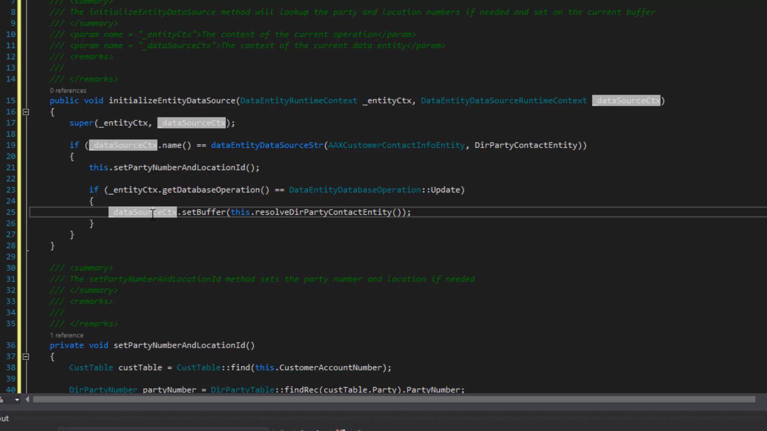
Toggle Breakpoints
F9

Slide 15
Go To (Main Thing)
Hit F9 in design view to go to the main thing for the item selected
F9 on a table extension will take you to the base table
F9 on a field will take you to the EDT
F9 on a field with a relationship will take you to the related table
F9 on a field in a data entity will open the table/entity for that field
F9 on COC Extension Class will take you to the main class

Slide 16
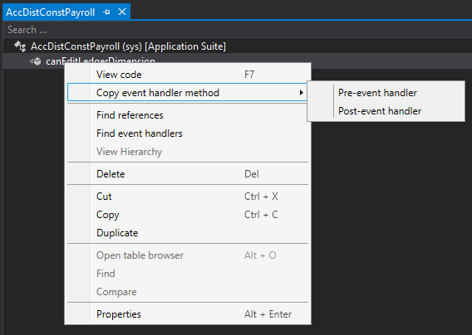
Copy Event Handlers - Methods
In design view, expand methods, right click, copy event handler

Slide 17
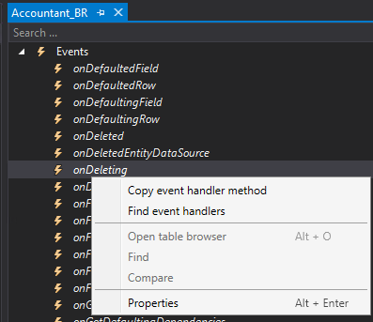
Copy Event Handler - Events
In design view, expand events, right click, copy event handler

Slide 18
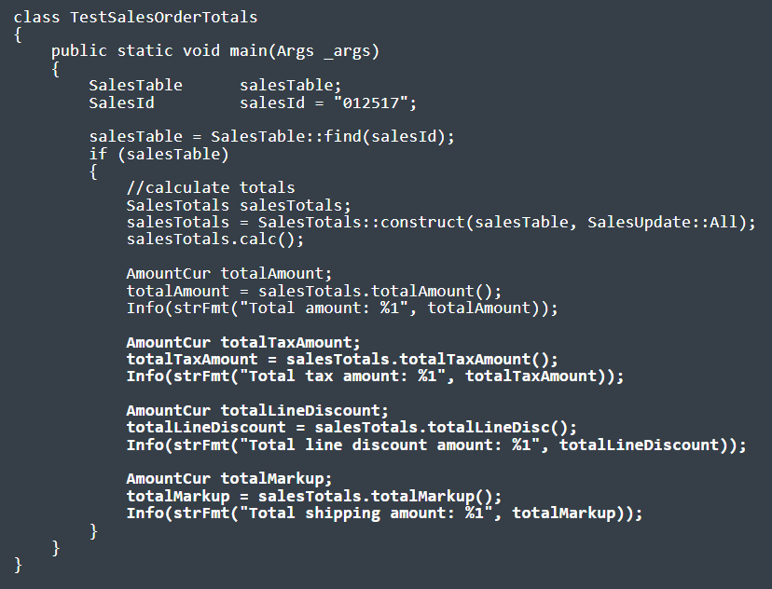

Sales order Totals
https://dynamics365musings.com/d365-sales-order-totals/

Slide 19
Extensible Controls
https://www.youtube.com/watch?v=QrIjTN6Vey4&t=149s
https://sangeethwiki.blogspot.com/2017/09/extensible-controls-in-dynamics-365-for.html
Use Javascript and html to create your own D365 controls.

Slide 20
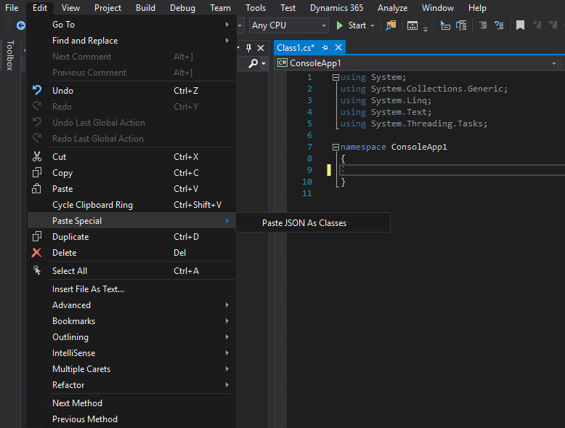
Paste Special
Edit > Paste Special
XML as Class
JSON as Class

Slide 21
Paste Special
{"menu": {
"id": "file",
"value": "File",
"popup": {
"menuitem": [
{"value": "New", "onclick": "CreateNewDoc()"},
{"value": "Open", "onclick": "OpenDoc()"},
{"value": "Close", "onclick": "CloseDoc()"}
]
}
}}
public class Menu
{
public string id { get; set; }
public string value { get; set; }
public Popup popup { get; set; }
}
public class Popup
{
public Menuitem[] menuitem { get; set; }
}
public class Menuitem
{
public string value { get; set; }
public string onclick { get; set; }
}

Slide 22
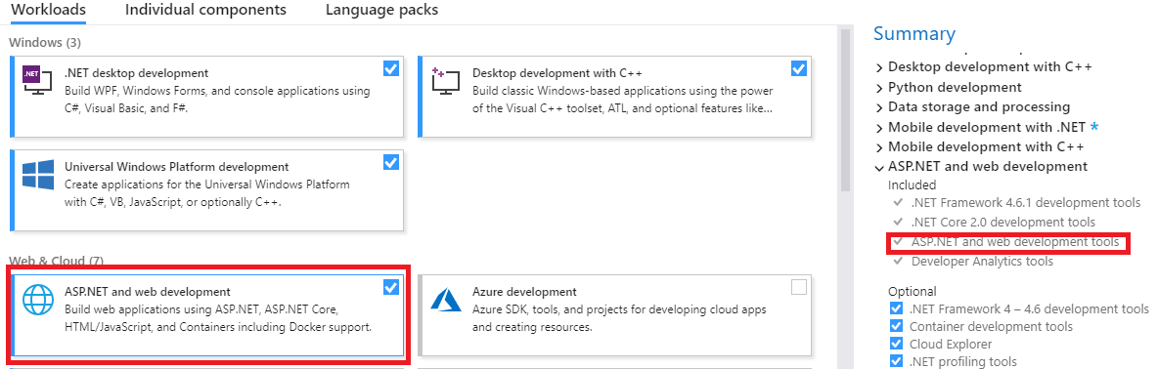
If XML Option Missing…
Add ASP.NET to VS

Slide 23
CrossCompany
static void JobDemoCrossCompany(Args _args)
{
BankAccountTable tabBAT; // saveDataPerCompany == true.
container conCompanies = [ 'cm1', 'cm2', 'dat' ];
str 4 sCompanyPrevious = " "; // Maximum length is 4 characters.
int iCountCompanies = 0;
;
while select
crossCompany
: conCompanies
* from tabBAT
order by dataAreaId
{
if ( sCompanyPrevious != tabBAT.dataAreaId )
{
info( tabBAT.dataAreaId + " = tabBAT.dataAreaId" );
iCountCompanies++;
if ( iCountCompanies >= 2 )
{
break;
}
sCompanyPrevious = tabBAT.dataAreaId;
}
}
return;
}

Slide 24
CrossCompany
BankAccountTable tabBAT; // saveDataPerCompany == true.
container conCompanies = [ 'cm1', 'cm2', 'dat' ];
str 4 sCompanyPrevious = " "; // Maximum length is 4 characters.
int iCountCompanies = 0;
;
while select
crossCompany
: conCompanies
* from tabBAT
order by dataAreaId
{
…
}
return;
}

Slide 25

CrossCompany Queries
static void JobDemoAllowCrossCompany(Args _args)
{
BankAccountTable tabBAT; // saveDataPerCompany == true.
Query qry2;
QueryBuildDataSource qbds3;
QueryRun qrun4;
str sCompanyPrevious = " ";
int iCountCompanies = 0;
int iTableNumBAT;
;
qry2 = new Query();
qry2.allowCrossCompany( true );
qry2.addCompanyRange( 'dat' );
qry2.addCompanyRange( 'twf' );
iTableNumBAT = tableNum( BankAccountTable );
qbds3 = qry2 .addDataSource( iTableNumBAT );
//qbds3.company( 'dat' );
qrun4 = new QueryRun( qry2 );
while ( qrun4.next() )
{
if ( qrun4.changed( iTableNumBAT ) )
{
tabBAT = qrun4.get( iTableNumBAT );
if ( sCompanyPrevious != tabBAT.dataAreaId )
{
print( tabBAT.dataAreaId + " = tabBAT.dataAreaId" );
iCountCompanies++;
if ( iCountCompanies >= 2 )
{
break;
}
sCompanyPrevious = tabBAT.dataAreaId;
}
}
}
pause;
return;
}

Slide 26
CrossCompany Queries
BankAccountTable tabBAT; // saveDataPerCompany == true.
Query qry2;
QueryBuildDataSource qbds3;
QueryRun qrun4;
str sCompanyPrevious = " ";
int iCountCompanies = 0;
int iTableNumBAT;
;
qry2 = new Query();
qry2.allowCrossCompany( true );
qry2.addCompanyRange( 'dat' );
qry2.addCompanyRange( 'twf' );

Slide 27
RunAsPermission
public static container download(container _parms)
{
RunAsPermission perm;
perm = new RunAsPermission("Admin");
perm.assert();
Container returncontainer = runAs("Admin", classnum(AcxSharepointIntegeration), "get", _parms);
CodeAccessPermission::revertAssert();
return returncontainer;
}
Notes:
https://allaboutdynamic.com/2020/07/07/runas-function-method-in-dynamics-365-finance-operations/

Slide 28
StrKeep
str Mobile = "712,3456789";
if (strLen(strRem(Mobile, ",")) != strLen(strKeep(strRem(Mobile, ","), "1234567890")))
{ throw error("Invalid Mobile Number"); }
else
{ info("Valid Mobile Number"); }
Notes:
https://allaboutdynamic.com/

Slide 29
StrRFix and StrLFix
static void testZeroPadding(Args _args)
{
int i = 1;
str padded;
str finalResult;
;
// Create a string, with a length of 5, ending with the value of i and padded with zeros
padded = strRFix(int2str(i), 5, "0");
finalResult = strFmt("ABC-%1", padded);
// 00001
}

Slide 30
Use C#
X++ is good but what it can’t do, C# can do
Call an external web service
Handle JSON/XML tedium
FTP

Slide 31
Use C#
class AAX_AzureQueueTest { const str connectionString = "Endpoint=sb://[urlName]servicebus.windows.net/;SharedAccessKeyName=[SharedAccessName];SharedAccessKey=[SharedAccessKey]=;EntityPath=[QueueName]"; public static void main(Args args) { AAX_AzureQueueLibrary.ReceiveAzureQueue ReceiveAzureQueue = new AAX_AzureQueueLibrary.ReceiveAzureQueue(); AAX_AzureQueueLibrary.SendAzureQueue SendAzureQueue = new AAX_AzureQueueLibrary.SendAzureQueue();
//x++ get a guid, not C# str s = "Test Message " + WinAPIServer::createGUID();
SendAzureQueue.connect(connectionString); SendAzureQueue.sendMessage(s); SendAzureQueue.close();
info(strFmt("sent: %1", s)); s = "";
ReceiveAzureQueue.connect(connectionString);
s = ReceiveAzureQueue.readMessage();
ReceiveAzureQueue.completeMessage();
ReceiveAzureQueue.close();
info(strFmt("Received: %1", s));
}
}

Slide 32
Other Stuff
Can’t locate an error that is being thrown? Add a breakpoint in info.Add() (on switch (logLevel))
Use funcName() to help with figuring problems out
QueryBuildDataSource.toString() to see the SQL for a query
Data Entities can be temperamental; DB Sync, delete entity (from Data Entity Screen), rebuild list, test again

Slide 33
D365 X++ Developer Playlist
https://dynamics365musings.com/d365-development-learning-playlist/

Slide 34
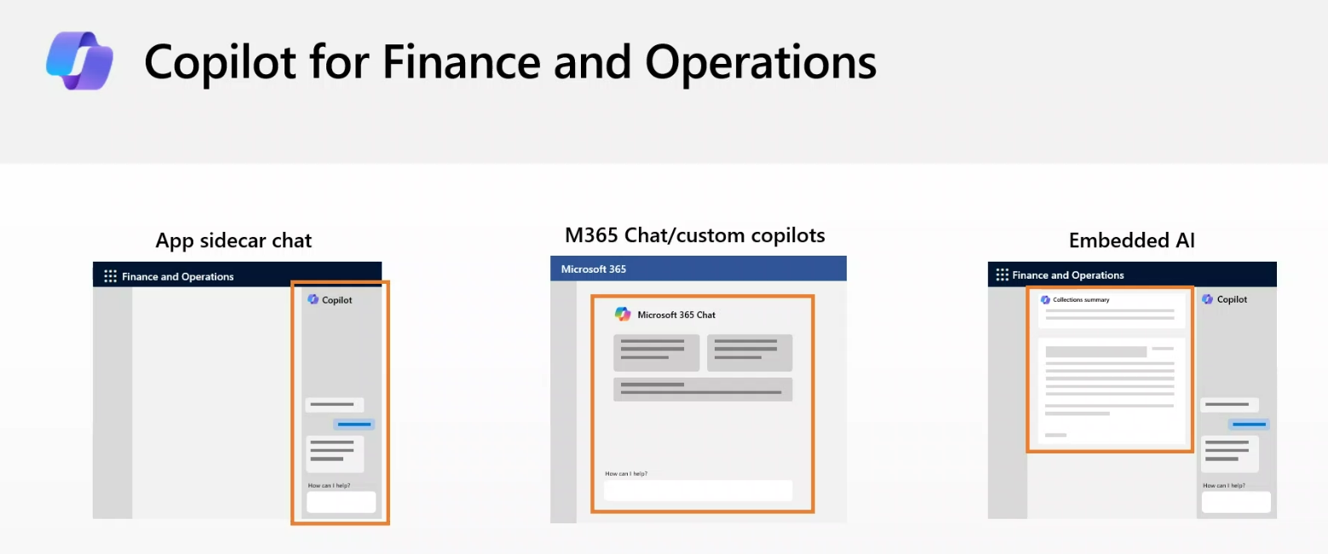
Extend Copilot capabilities
https://learn.microsoft.com/en-us/dynamics365/fin-ops-core/dev-itpro/copilot/extend-copilot

Slide 35
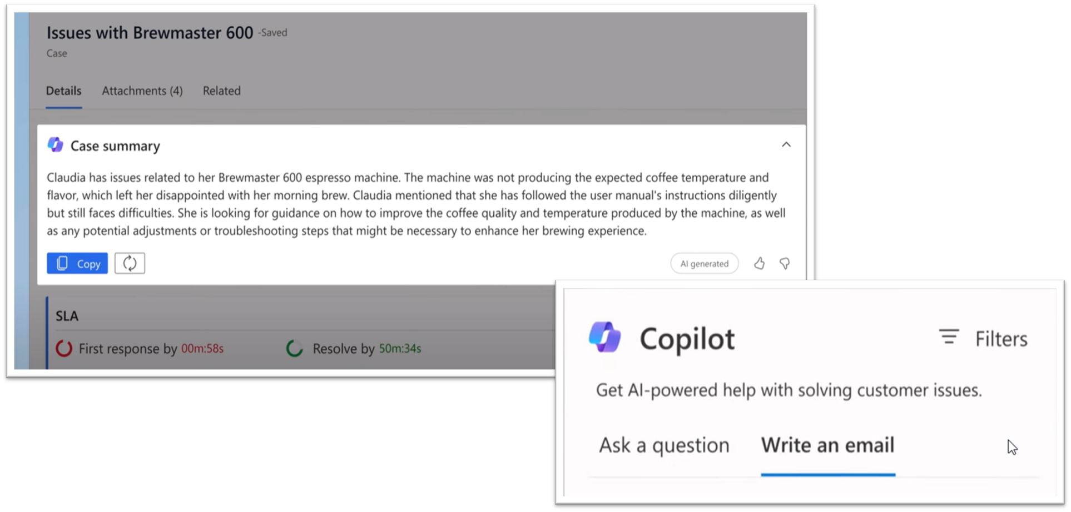
Copilot capabilities

Slide 36
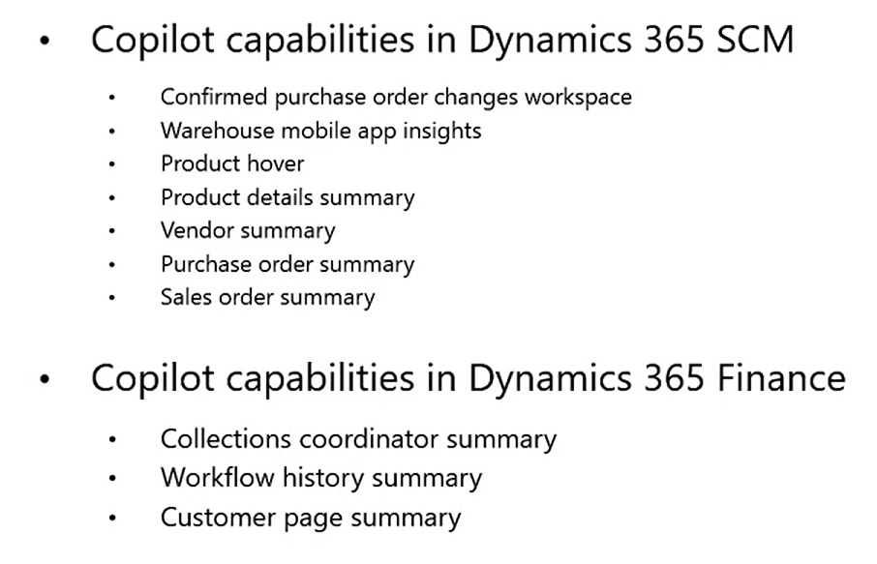
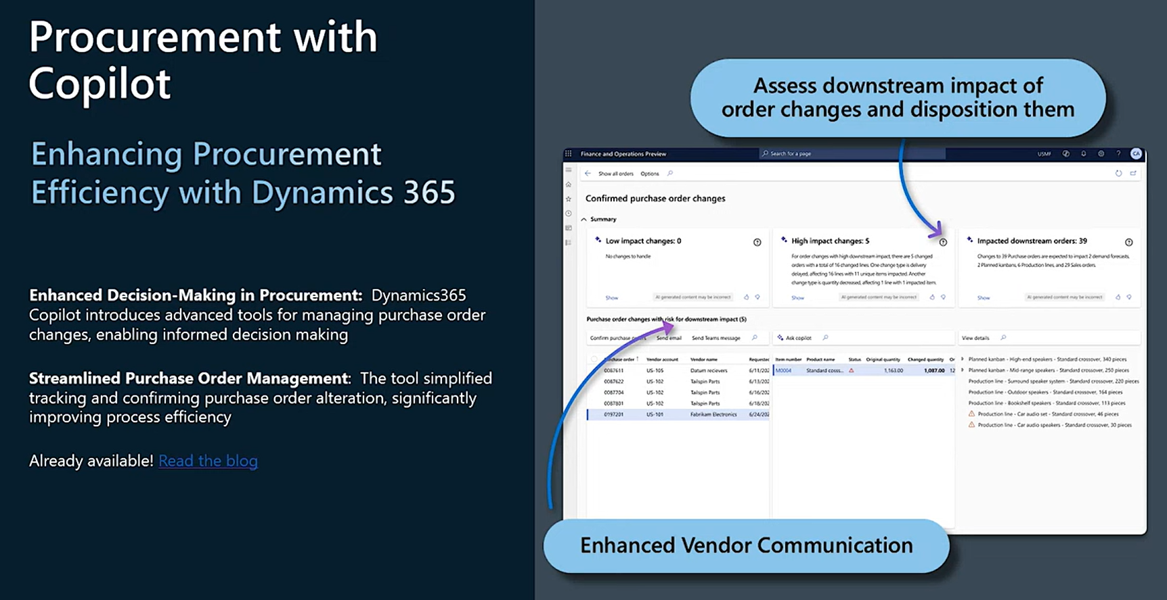
Copilot capabilities

Slide 37
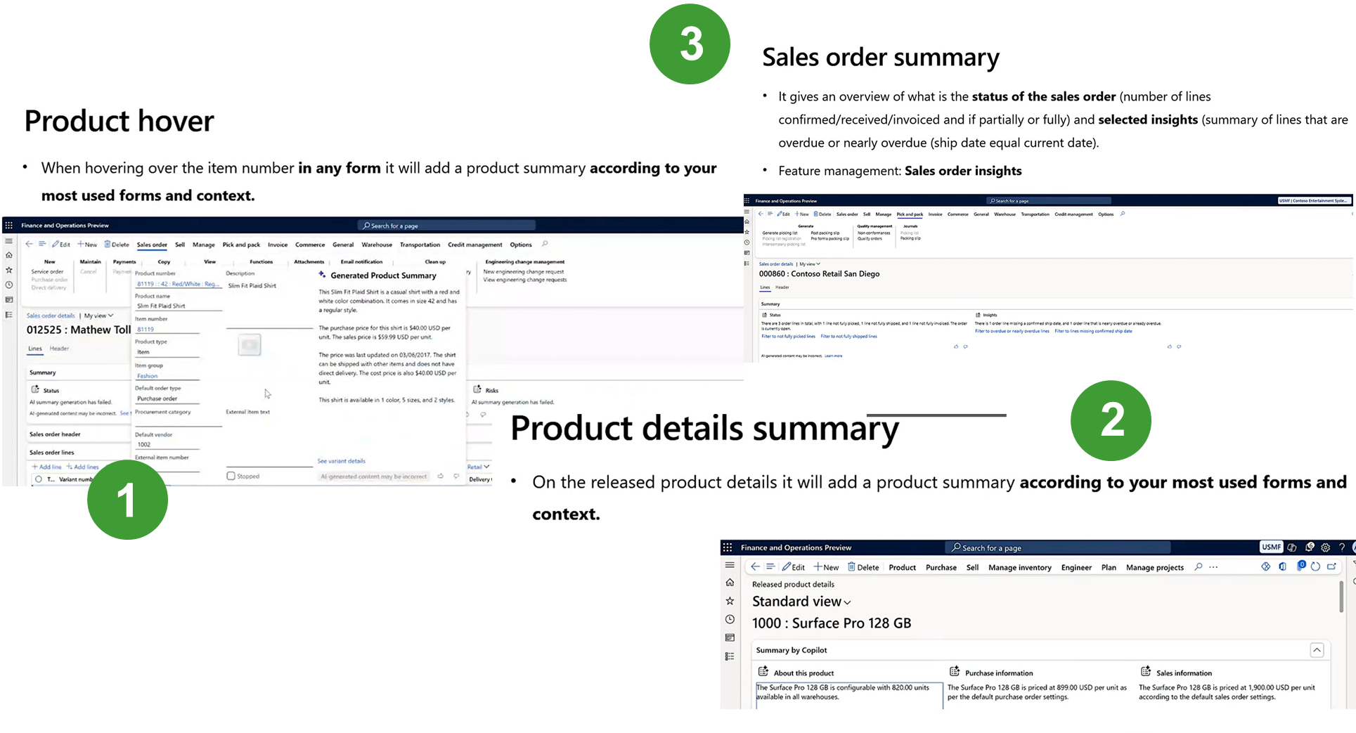
Copilot capabilities

Slide 38
Use Batch Jobs
Top Picking: https://www.atomicax.com/blog-entry/batchretryable-top-picking-batch-job-example
Bundles: https://www.atomicax.com/blog-entry/batchretryable-bundled-batch-job-example
Induvial Task Models: https://www.atomicax.com/blog-entry/batchretryable-individual-task-modeled-batch-job-example
“Classic”: https://www.atomicax.com/blog-entry/batchretryable-runbasebatch-class
Also review Process Automations

Slide 39
Misc Grab Bag
Use buf2Buf() for copying the contents of one buffer to another.
Apply select firstOnly1 when you expect a single record to optimize performance.
Use Views rather than doing complex joins in a query statement

Slide 40
D365FO.Tools

Slide 41
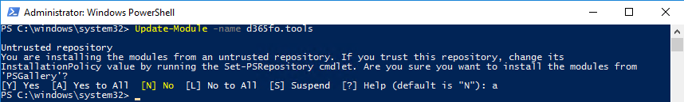
D365FO.Tools
PowerShell module to handle the different management tasks during a Dynamics 365 Finance & Operations
Install-Module -Name d365fo.tools
Update-Module -name d365fo.tools

Slide 42
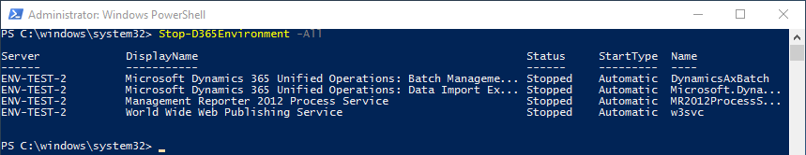
Stop An Environment
Stop-D365Environment -All
Stop-D365Environment -Aos -Batch
Stop-D365Environment -FinancialReporter -DMF
Stop-D365Environment -All -Kill

Slide 43
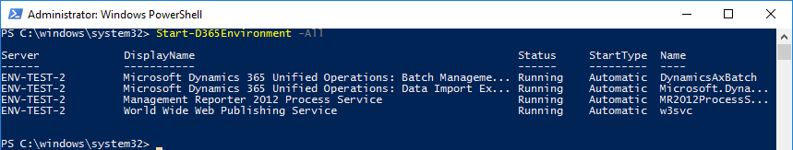
Start An Environment
Start-D365Environment -ShowOriginalProgress
Start-D365Environment -All
Start-D365Environment -Aos -Batch
Start-D365Environment -FinancialReporter -DMF

Slide 44
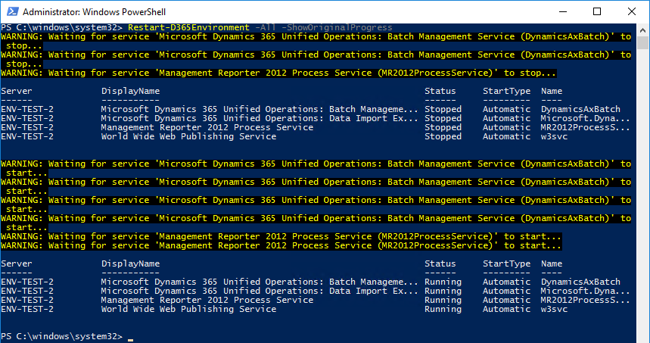
Restart
Restart-D365Environment -All -ShowOriginalProgress

Slide 45
(Re)Set D365FO Admin
Set-D365Admin "claire@contoso.com"

Slide 46
Export Database from Sandbox
Invoke-D365LcsDatabaseExport -ProjectId 123456789 -SourceEnvironmentId "958ae597-f089-4811-abbd-c1190917eaae" -BackupName "BackupViaApi" -BearerToken "JldjfafLJdfjlfsalfd..." -LcsApiUri "https://lcsapi.lcs.dynamics.com"
Notes:
https://blog.simonw.se/getting-an-access-token-for-azuread-using-powershell-and-device-login-flow/

Slide 47
Refresh Database (Prod To Sandbox)
Invoke-D365LcsDatabaseRefresh -ProjectId 123456789 -SourceEnvironmentId "958ae597-f089-4811-abbd-c1190917eaae" -TargetEnvironmentId "13cc7700-c13b-4ea3-81cd-2d26fa72ec5e" -BearerToken "JldjfafLJdfjlfsalfd..." -LcsApiUri "https://lcsapi.lcs.dynamics.com"
Notes:
https://blog.simonw.se/getting-an-access-token-for-azuread-using-powershell-and-device-login-flow/

Slide 48
Sync Database for Module(s)
Invoke-D365DbSyncModule -Module "MyModel1"
Invoke-D365DbSyncModule -Module "MyModel1","MyModel2"
Get-D365Module -Name "MyModel*" | Invoke-D365DbSyncModule

Slide 49
Partial DB Sync
Invoke-D365DBSyncPartial -SyncList "CustCustomerEntity","SalesTable"
Invoke-D365DBSyncPartial -SyncList "CustCustomerEntity","SalesTable" -Verbose

Slide 50
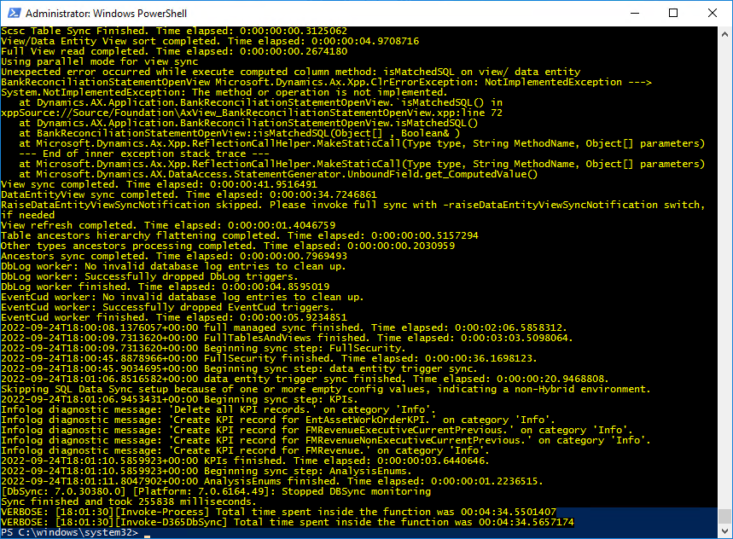
DB Sync
Invoke-D365DBSync
Invoke-D365DBSync -Verbose

Slide 51
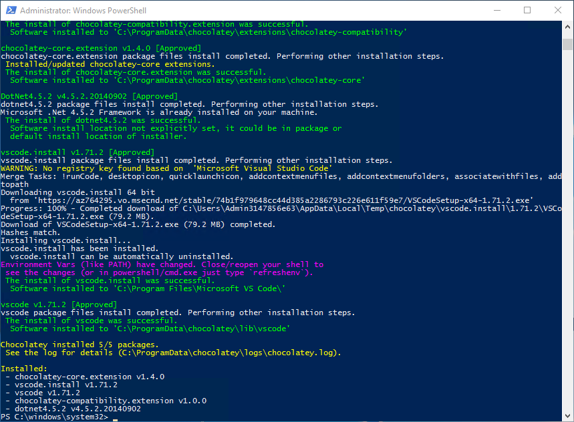
Install Supporting Software
Install-D365SupportingSoftware -Name vscode
Install-D365SupportingSoftware -Name "vscode","fiddler"
Install-D365SupportingSoftware -Name googlechrome

Slide 52
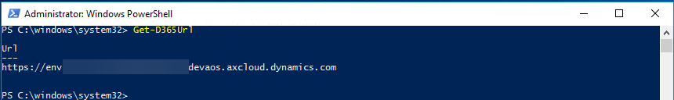
Getting Environment URL
Get-D365Url

Slide 53
Searching for an AOT Object
Get-D365AOTObject -Name *flush* -ObjectType AxClass -Path "C:\AOSService\PackagesLocalDirectory\ApplicationFoundation"
Get-D365AOTObject -Name *flush* -ObjectType AxClass -IncludePath -Path "C:\AOSService\PackagesLocalDirectory\ApplicationFoundation"
Get-D365InstalledPackage -Name Application* | Get-D365AOTObject -Name *flush* -ObjectType AxClass
Get-D365AOTObject -Path "C:\AOSService\PackagesLocalDirectory\*" -Name *flush* -ObjectType AxClass -SearchInPackages

Slide 54
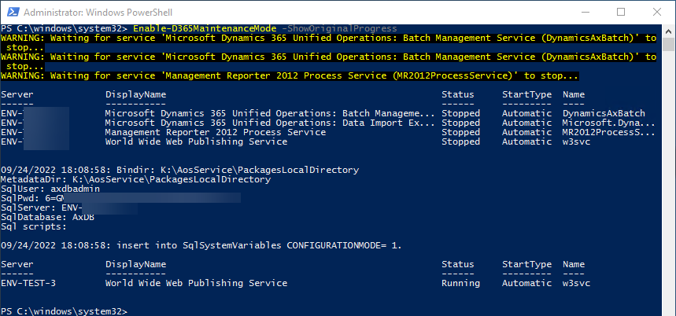
Maintenance Mode
Enable-D365MaintenanceMode -ShowOriginalProgress
Disable-D365MaintenanceMode -ShowOriginalProgress

Slide 55
Import Database into Dev (T1)
Invoke-D365InstallSqlPackage
Import-D365Bacpac -ImportModeTier1 -BacpacFile "C:\temp\uat.bacpac" -NewDatabaseName "ImportedDatabase_YYYYMMDD"

Slide 56
Export Database from Dev (T1)
New-D365Bacpac -ExportModeTier1 -BackupDirectory c:\Temp\backup\ -NewDatabaseName Testing1 -BacpacFile "C:\Temp\Bacpac\Testing1.bacpac"

Slide 57
Quality Of Life

Slide 58
Copy data from excel to D365 grid
https://learn.microsoft.com/en-us/dynamics365/fin-ops-core/fin-ops/get-started/grid-capabilities
Just copy and paste.
Plus, lots of other features (Enabled in Feature Management)

Slide 59
Table Browser
https://dynamics365musings.com/d365-table-browser/
https://<environmentURL>/?mi=SysTableBrowser&tablename=<tablename>

Slide 60
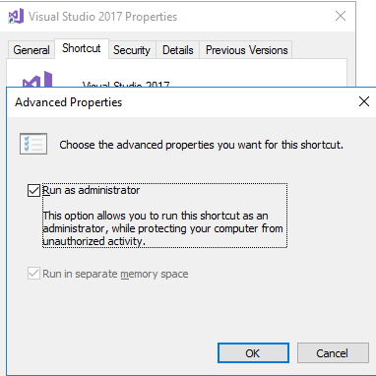
Run Visual Studio as Admin
Start
Search for Visual Studio 2017
Right click > Open file location
Find icon, right click > Properties > Advanced
Check “Run As Administrator”

Slide 61
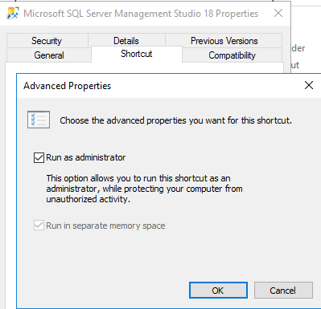
Run SSMS as Admin
Nearly the same as for VS 2017

Slide 62
Extend Archive Framework
https://learn.microsoft.com/en-us/dynamics365/fin-ops-core/dev-itpro/sysadmin/archive-custom#finance-and-operations-table-names-in-live-history-and-dataverse-managed-data-lake-tables
The archival framework supports extensions to include custom table fields and custom tables in supported functional scenarios.
Custom fields that are added to a standard table must be added to the corresponding history table and the business intelligence (BI) entity.
Extend the ArchiveAutomationJobRequestCreator class for a scenario to add the new table to archive table chart.

Slide 63
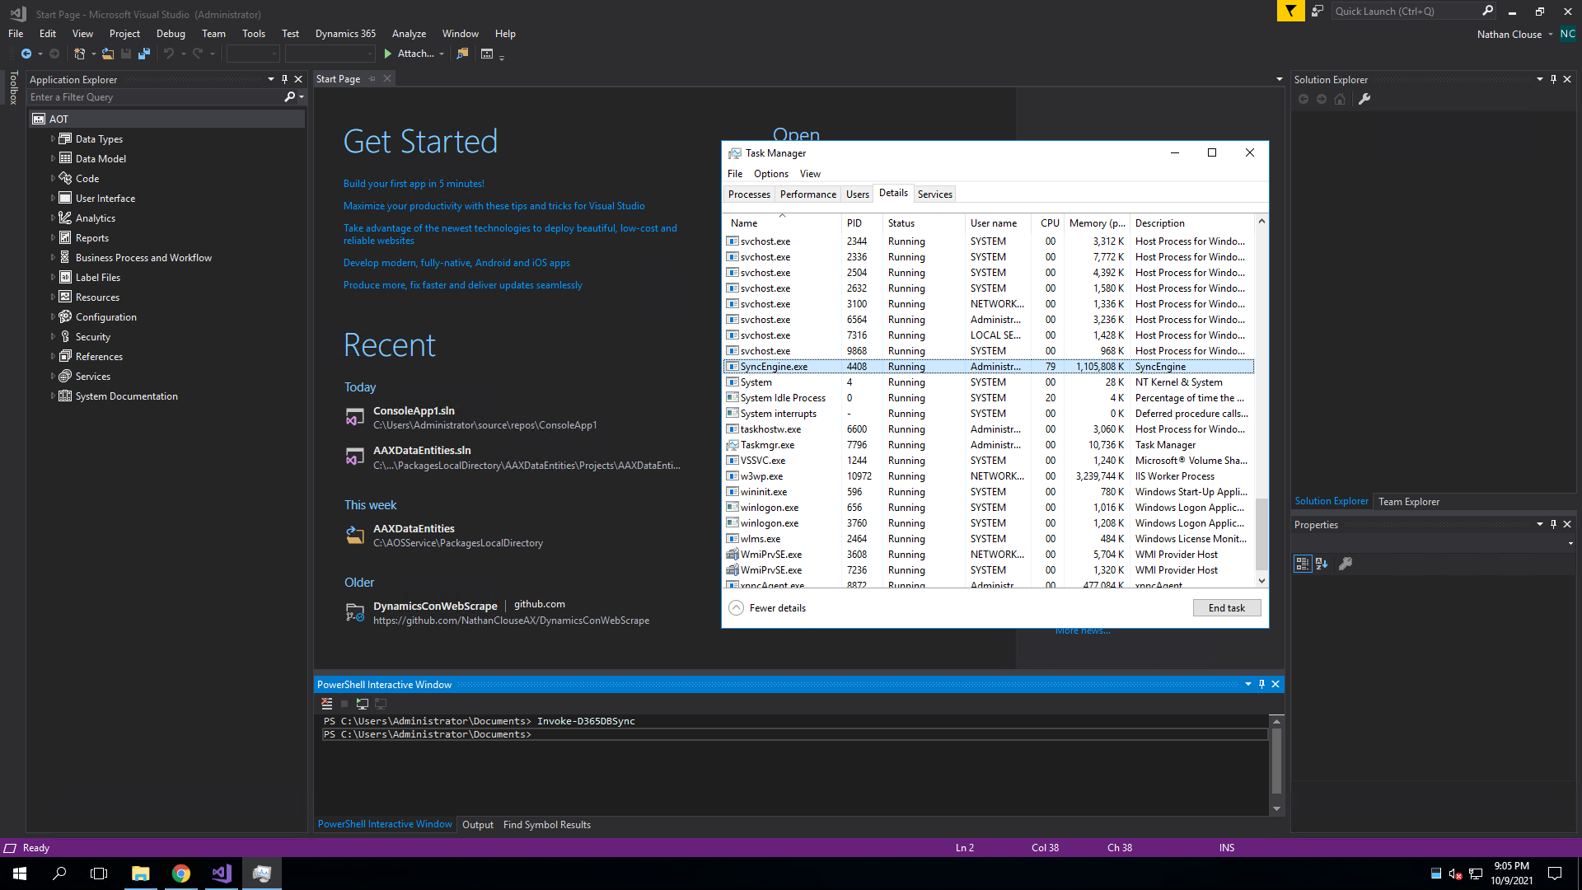
Run D365FO.Tools in VS
Run PowerShell from VS
Like D365FO.Tools
Notes:
http://www.atomicax.com/article/d365fotools-and-vs2017-manhattan-project

Slide 64

Notes:
http://www.atomicax.com/article/d365fotools-and-vs2017-manhattan-project

Slide 65
Run D365FO.Tools in VS
Run PowerShell from VS
Like D365FO.Tools
Notes:
http://www.atomicax.com/article/d365fotools-and-vs2017-manhattan-project

Slide 66

Plus Aliases
Use notepad $profile

Slide 68
Querying in SQL w/ nolock
Using NOLOCK when directly querying SQL can show uncommitted records
Useful when debugging
I.e.: SELECT * FROM SalesTable WITH (nolock) WHERE SalesId = ‘SO04381969’
AND DataAreaId = ‘USMF’

Slide 69
Debugging

Slide 70
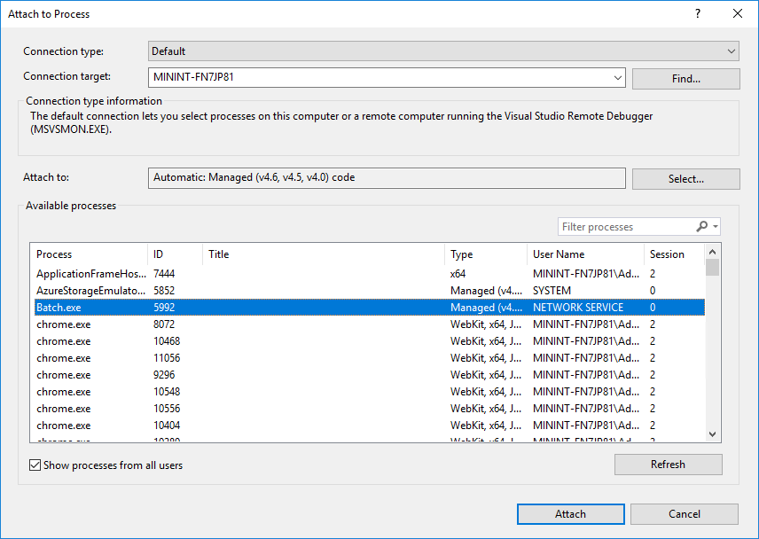
Debugging Batch Jobs
Attached to process
Show all processes from all users
Look for Batch.exe

Slide 71
Debugging with a UDE
Just Launch the debugger
That’s it.

Slide 72
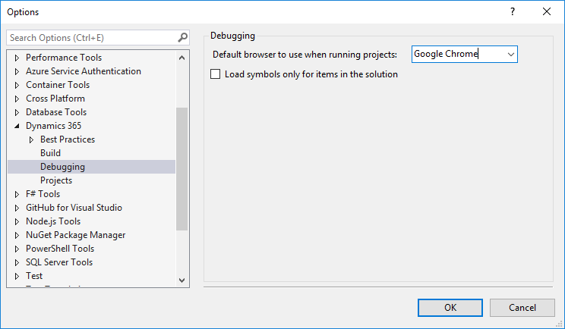
Loading Symbols
Tools > Options

Slide 73
Loading Symbols

Slide 74
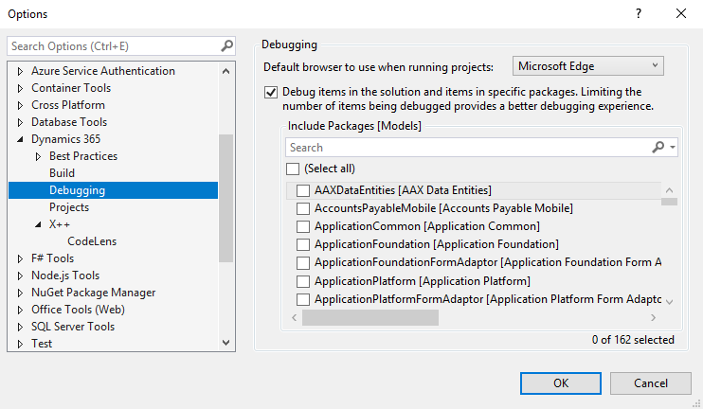
Loading Symbols

Slide 75
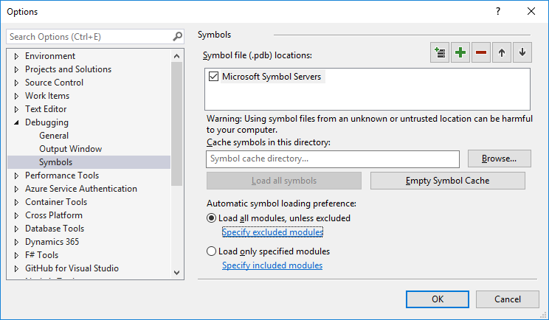
Load all modules

Slide 76
Visual Studio Hidden Gems

Slide 77
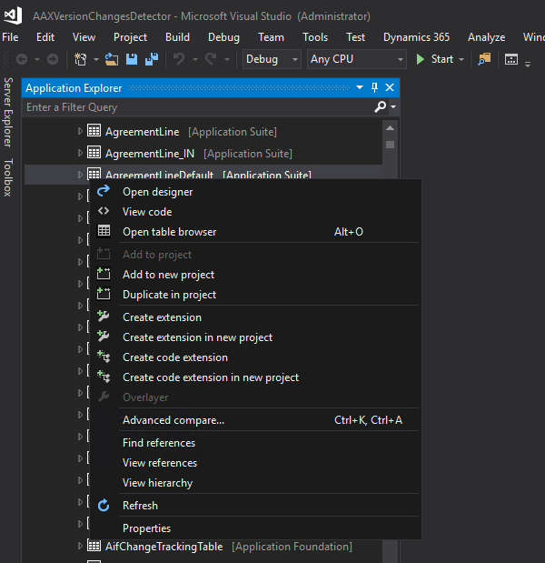
Create code extension
Create code extension

Slide 78
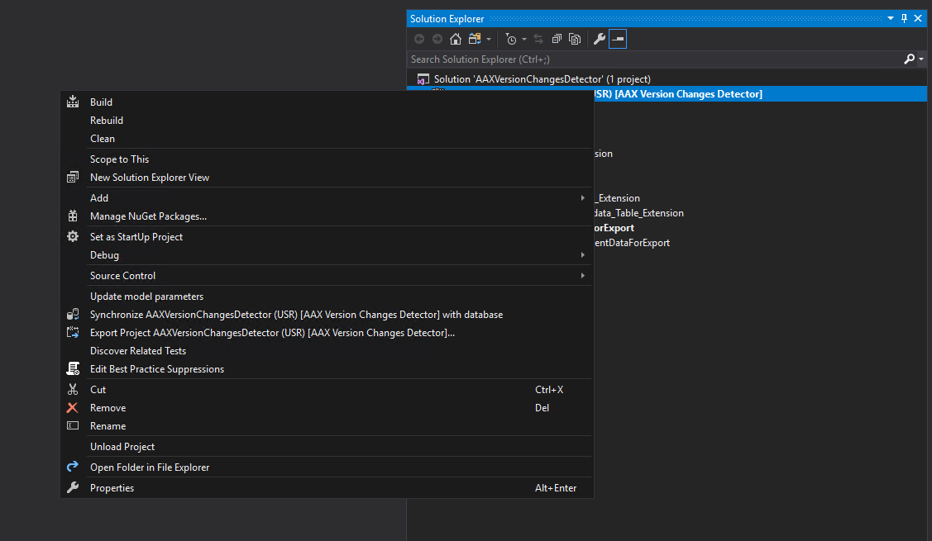
Update Model Parameters
Update model parameters

Slide 79
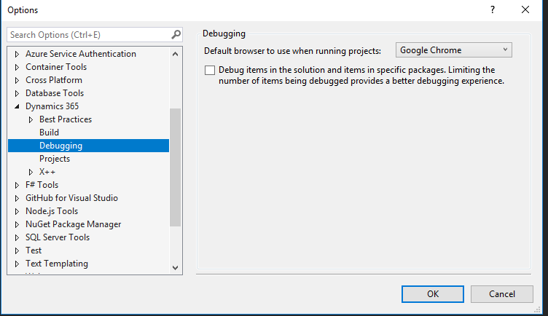
Debug items in solution

Slide 80
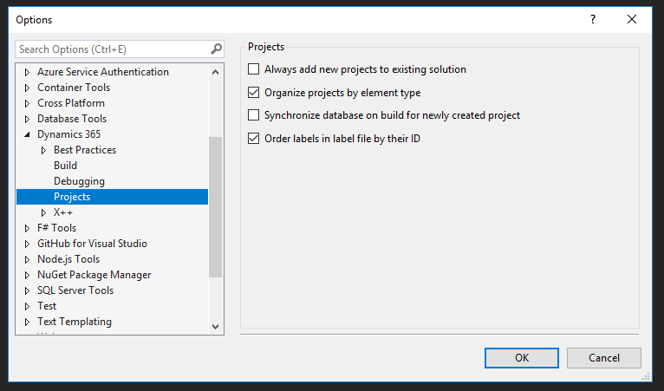
Order Labels in label file by ID

Slide 81
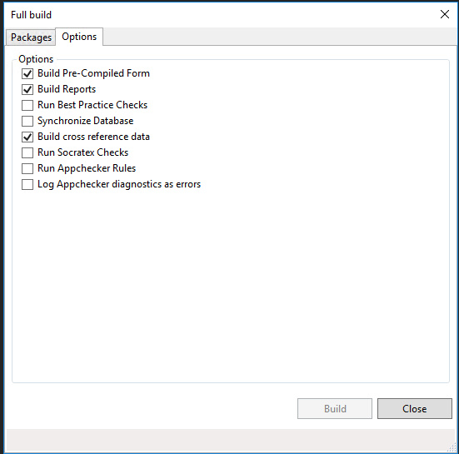
Build Options

Slide 82
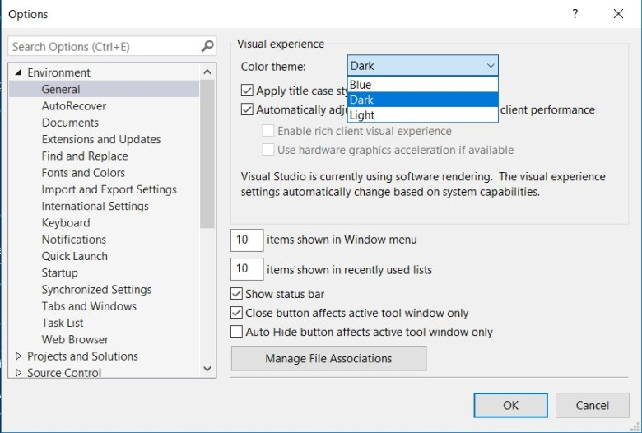
Dark Mode Plus Custom Colors
Notes:
https://jatomas.com/en/2020/05/02/dark-mode-visual-studio-x-code-editor/

Slide 83
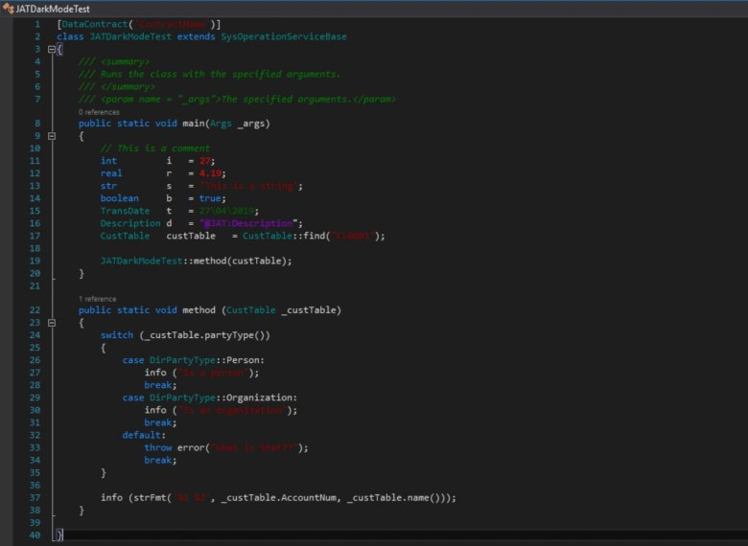
Notes:
https://jatomas.com/en/2020/05/02/dark-mode-visual-studio-x-code-editor/

Slide 84
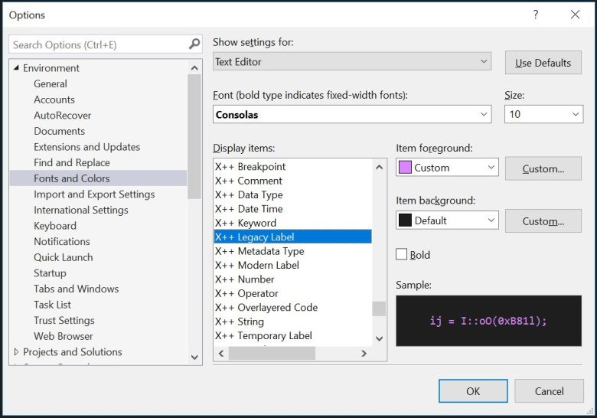
Dark Mode Plus Custom Colors
Notes:
https://jatomas.com/en/2020/05/02/dark-mode-visual-studio-x-code-editor/

Slide 85
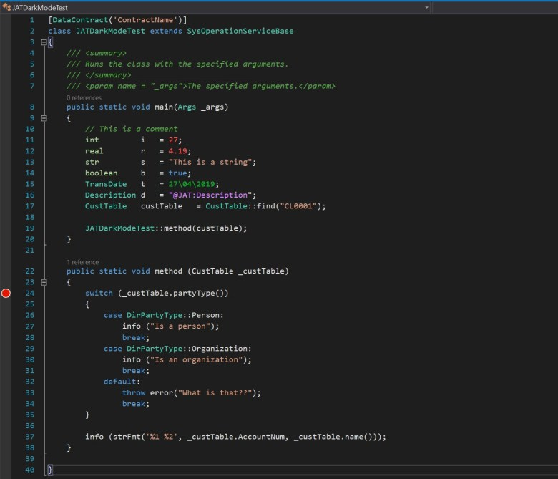
Notes:
https://jatomas.com/en/2020/05/02/dark-mode-visual-studio-x-code-editor/

Slide 86
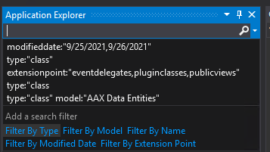
Metadata Search
Search on any option, value, metadata, whatever, on an element
type:"form" ccount
type:"class" extensionpoint:"eventhandlers,eventdelegates"

Slide 87
Metadata Search
type:"dataentityview" property:"PublicCollectionName=CustomerStatisticsGroups"
type:"dataentityview" property:"PublicEntityName=CustomerStatisticsGroup"

Slide 88
TRUDUtilsD365
Open Source
https://github.com/TrudAX/TRUDUtilsD365
Prototyping Tools that help with productivity
Configurable
Similar idea from AX 2009/2012 with configurable MorphX tools

Slide 89
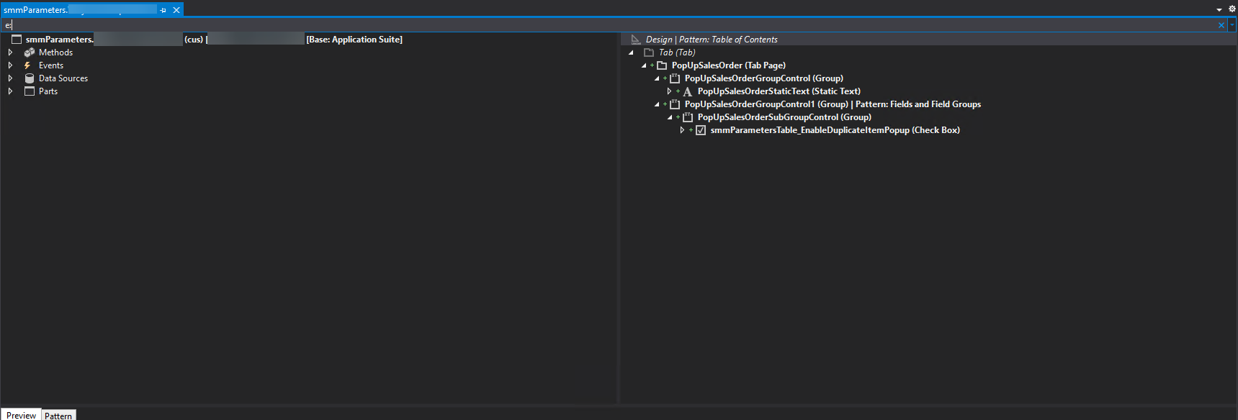
VS E: on Form Extensions

Slide 90
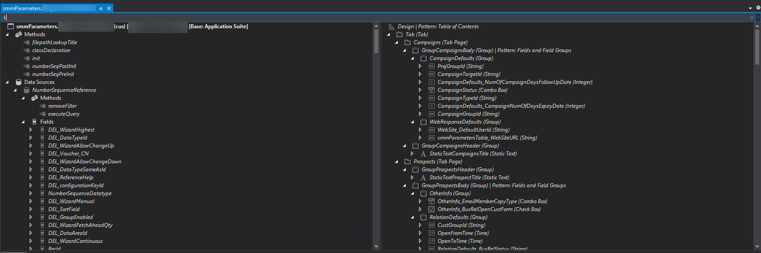
VS L: on Form Extensions

Slide 91
New Things for UDE’s

Slide 92
UDE Things
First, check out UDEs if you haven't heard of them yet
Build models, not projects or solutions
Better support for Git with configurable metadata
You get everything with your UDE so you can test your data entities in a dual write scenario, or power automate, virtual tables, etc
JIT data access
(sigh) Copilot
Microservices are available
Availability based on storage

Slide 93
Resources
http://www.atomicax.com/article/d365fotools-and-vs2017-manhattan-project
https://docs.microsoft.com/en-us/dynamics365/fin-ops-core/dev-itpro/dev-ref/xpp-business-run-time-functions
https://docs.microsoft.com/en-us/dynamics365/fin-ops-core/dev-itpro/dev-ref/xpp-string-run-time-functions
https://jatomas.com/en/2020/05/02/dark-mode-visual-studio-x-code-editor/
https://dynamics365musings.com/d365-sales-order-totals/
https://www.youtube.com/watch?v=QrIjTN6Vey4&t=149s
https://sangeethwiki.blogspot.com/2017/09/extensible-controls-in-dynamics-365-for.html

Slide 94
Resources
https://ariste.info/en/2021/06/socratex-application-checker/
https://github.com/TrudAX/TRUDUtilsD365
https://devblogs.microsoft.com/powerplatform/the-unified-development-environment-is-ga/
https://learn.microsoft.com/en-us/power-platform/developer/unified-experience/finance-operations-dev-overview
https://dynamics365musings.com/x-development-boost-your-development-skills-with-proven-tips-and-tricks/

Slide 95
Questions?

Slide 96
Thanks!
Nathan Clouse
nclouse@armaninollp.com
www.atomicax.com
www.dynamics.fo
@NathanClouseAX
https://www.linkedin.com/in/nathanclouseax/
Peter Ramer
www.dynamics365musings.com
https://www.linkedin.com/in/peter-ramer/

Slide 98
AX/FINANCE & OPS
© 2024 Dynamic Communities. All rights reserved.

